Slide 1
Interface Presentation
By spirits

Slide 2
Group members
Member | Roles
Jiazheng Pan | Project Manager and Liaison
Haotian Tang | Programmer and Requirement Analyst
Weibin Cheng | System Architect and Tester
Carlos | Tester
Notes:
Hello, everyone. I'm glad to meet you guys in today's meeting. It is really a precious opportunity that we can meet here together across such a long distance and discuss about our final achievement. My name is Pan Jiazheng, and I'm the program manager and liaison of the Interface group, Spirits. We have four members in our group, me, Tang Haotian, Cheng Weibin and Carlos from Portugal. And these are roles of our members.

Slide 3
OUR interface
Notes:
Since Zhou Wenhui has demonstrated the integral test with our interface, I believe everyone has a clear understanding about our work. And just now the main function buttons were also displayed and tried, so there is no need for me to repeat them once again. Next I will just make a supplementary explanation and simply introduce our interface. I will talk a little bit more about our phased work.

Slide 4
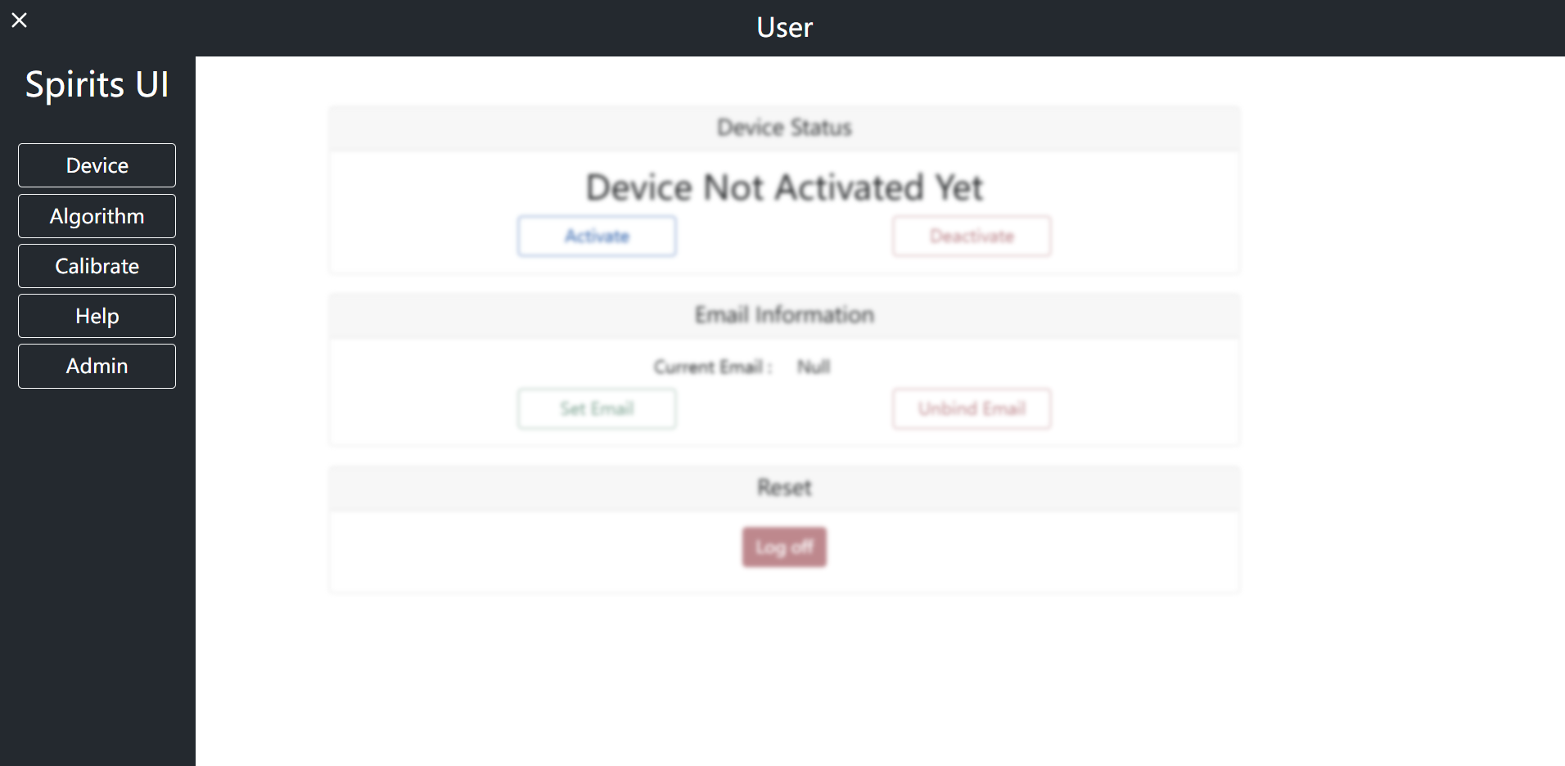
User interface

Slide 5
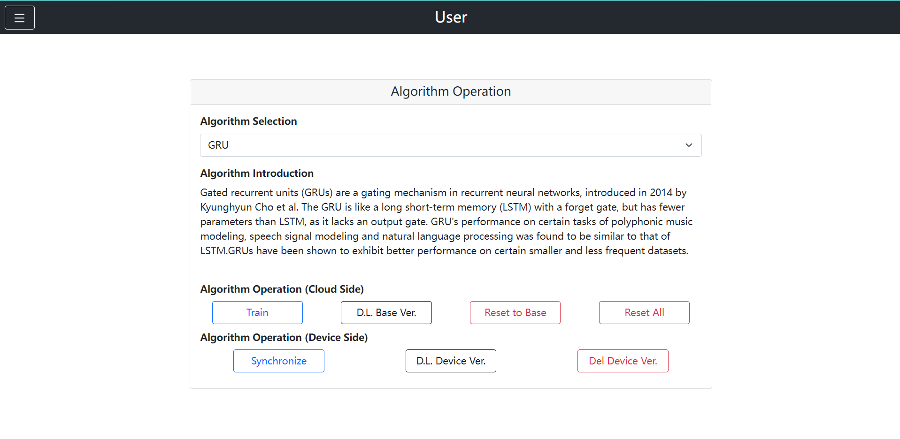
algorithm

Slide 6
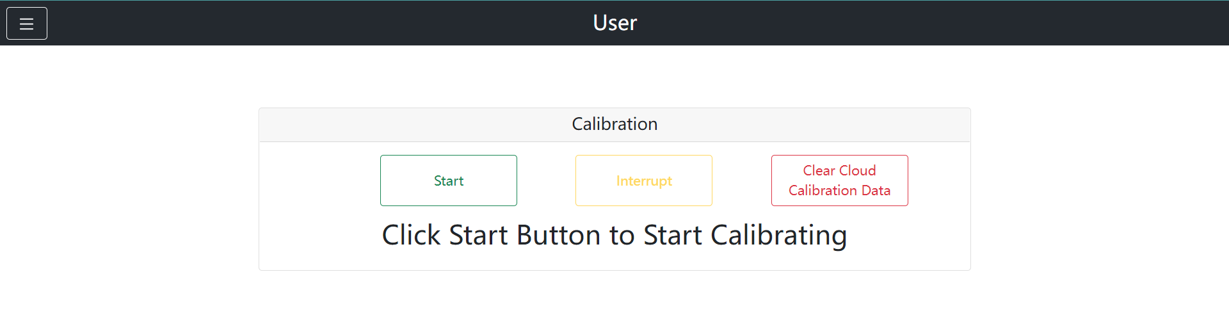
calibration

Slide 7
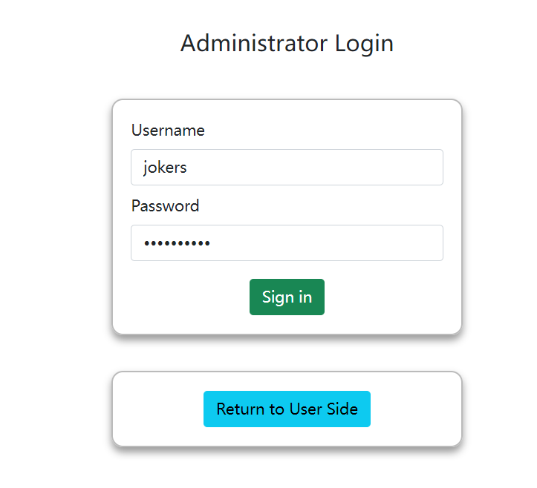
Administrator login

Slide 8
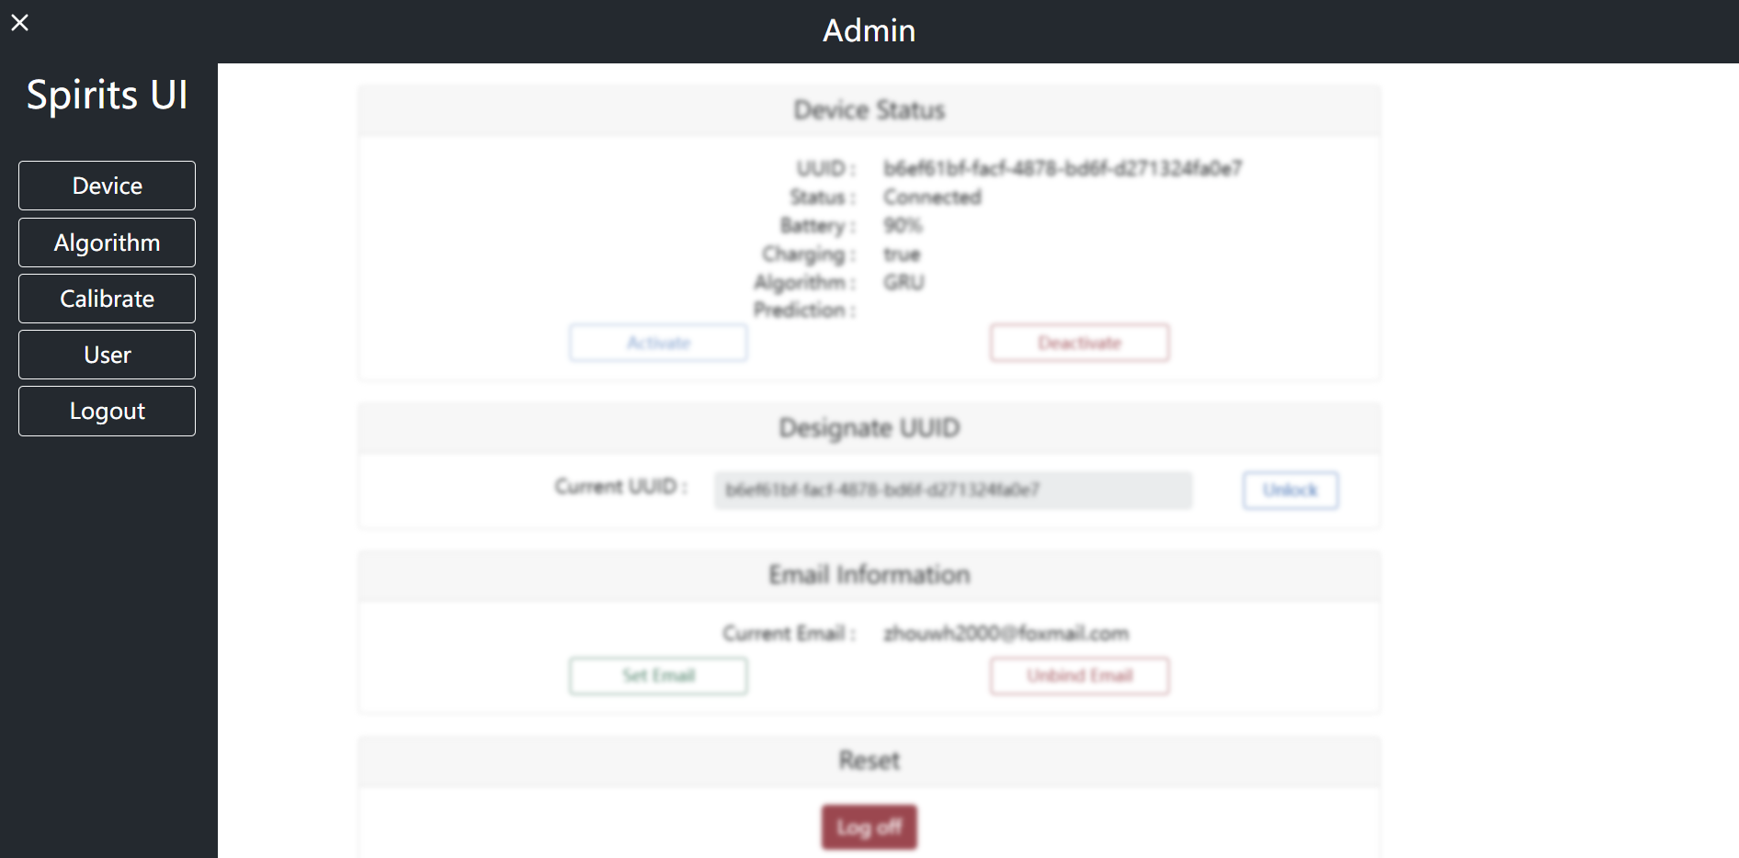
ADMINISTRATOR INTERFACE

Slide 9
OUR WORK
Notes:
Since Zhou Wenhui has demonstrated the integral test with our interface, I believe everyone has a clear understanding about our work. And just now the main function buttons were also displayed and tried, so there is no need for me to repeat them once again. Next I will just make a supplementary explanation and simply introduce our interface. I will talk a little bit more about our phased work.

Slide 10
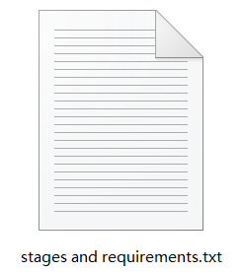
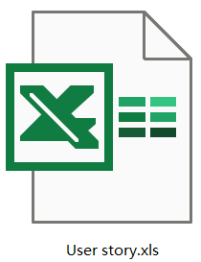
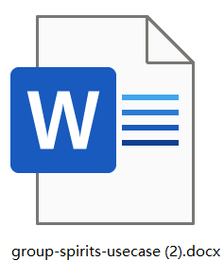
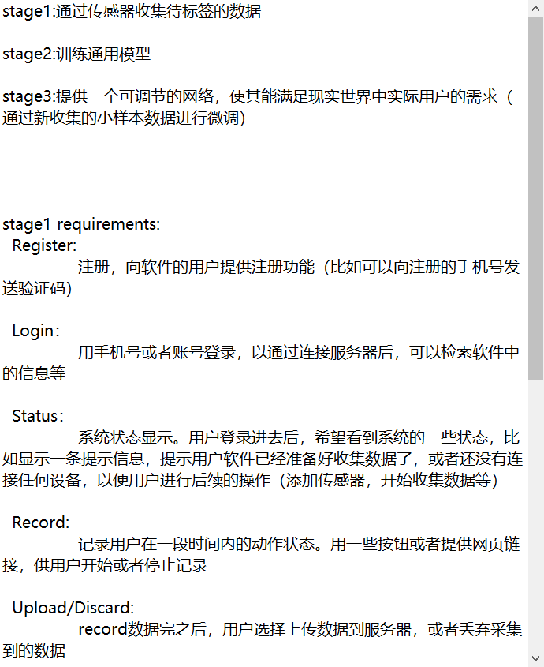
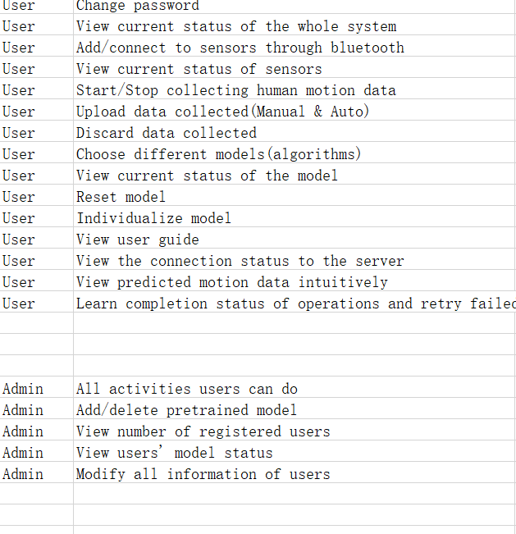
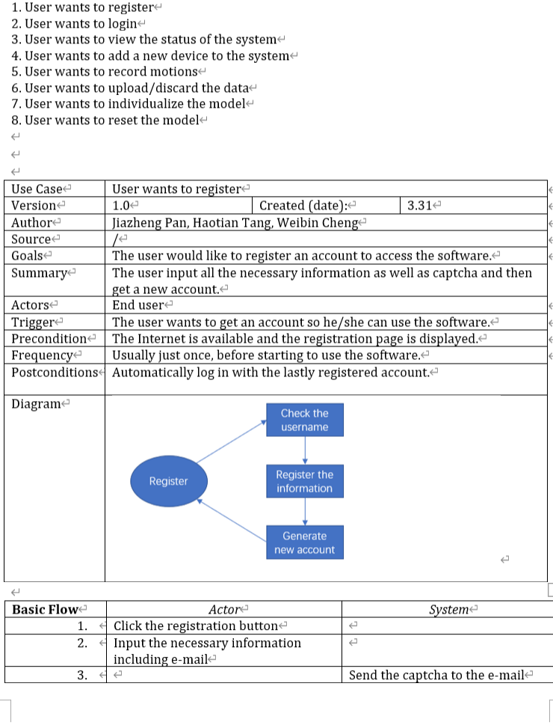
Documentation work
Notes:
First is the document work. Here I list some documents used in our work, including stage and requirements, user story, use case, api explanation doc, etc. To show our documents, I put some screenshots of documents here, as you can see in the slide. Because some documents are used in our internal design, for convenience we wrote them in Chinese.
Stages and requirements file is used to roughly determine requirements and different stages.
User stories file is used to describe what users may intend to do.
User case file is used to refine user stories and determine operation steps.

Slide 11
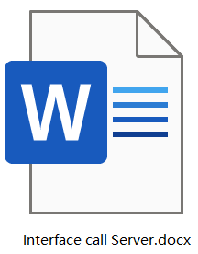
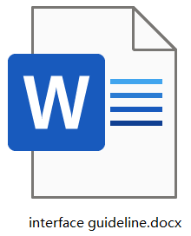
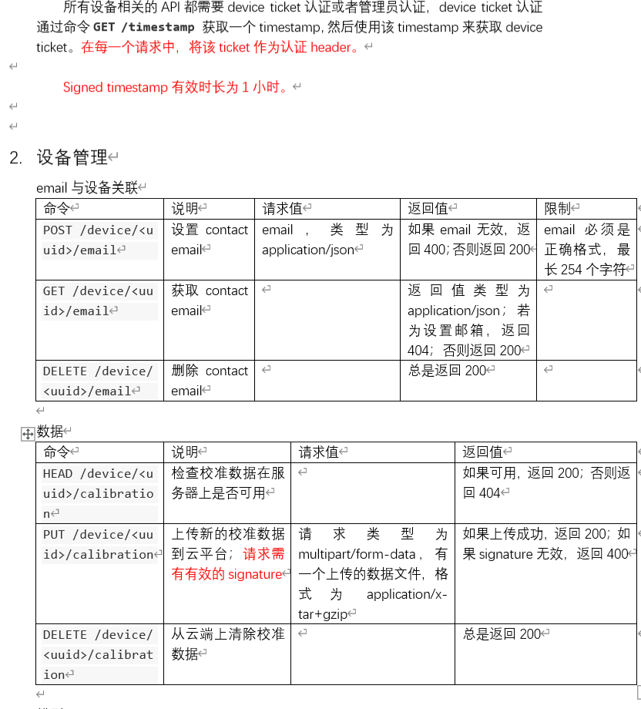
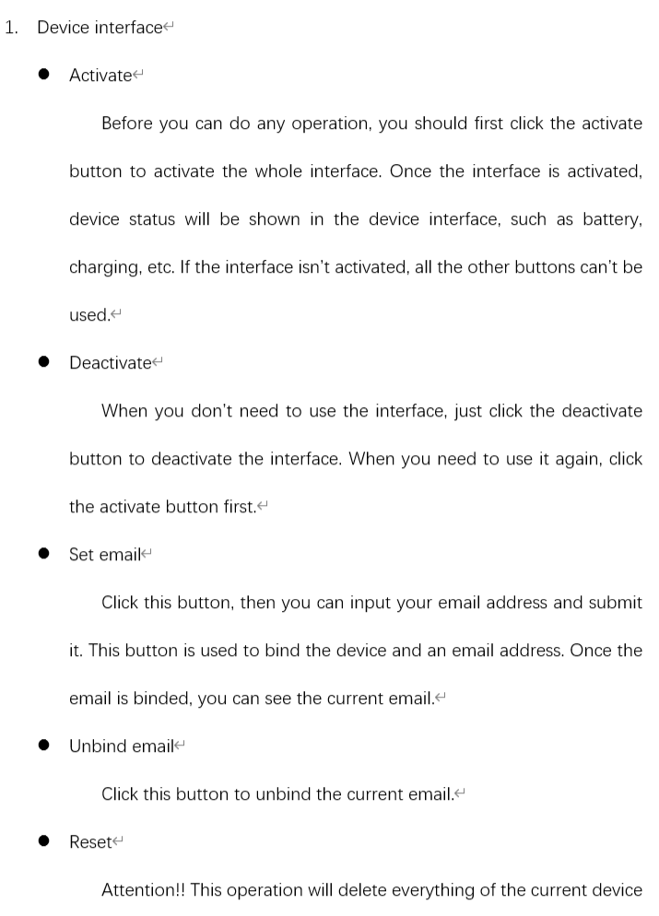
Documentation work
Notes:
Interface call server file was wrote by ourselves and used only in our group. Because the software design specification doc is a little troublesome to read and use, I extracted detailed api information related to our job and arranged them into one word. Thus the subsequent coding work may be more convenient according to this word.
Interface guideline file is written for users to figure out functions of the buttons and get to know how to use our interface.

Slide 12
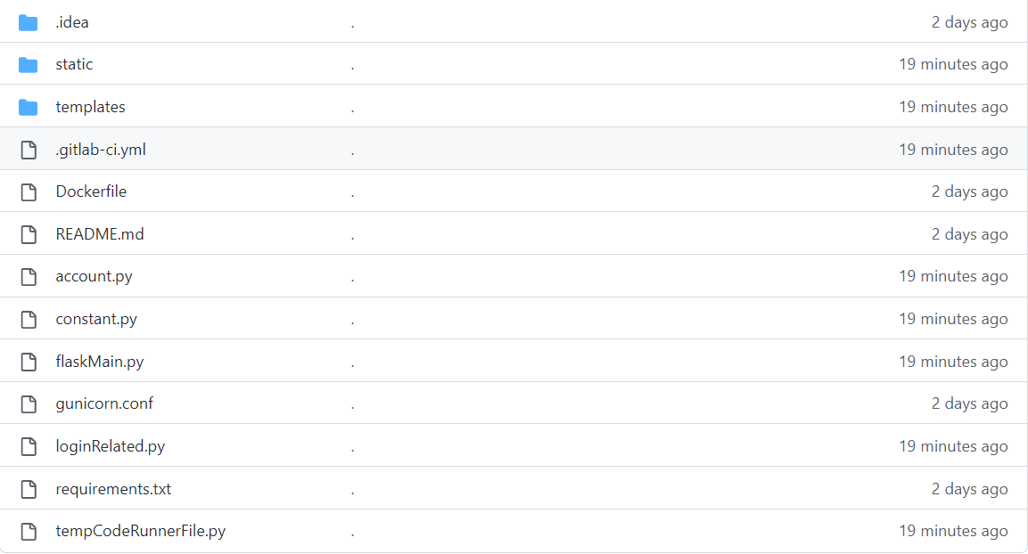
CODE WORK
Notes:
Next is the code work. Here is a screenshot of our code structure. You can see that it is a conventional front end structure with python, html, javascript and css file. Outside are some frequently used files, for example, flaskMain.py is used to launch the website, loginRelated.py is used for administrator login, etc. In the templates folder, there are user related html pages and admin related html pages, and they are clearly divided. In the static folder, there are javascript files and css files connected with html files. Also there are images. Thanks to my teammates, we have a clear code project.

Slide 13
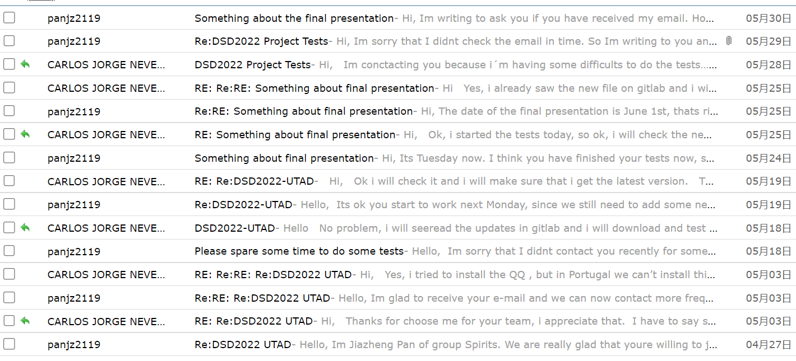
COMMUNICATION AND COORDINATION
Notes:
Then is the communication and coordination work. We students from Jilin University can communicate with each other easily, so the main task of this work is to keep in contact with Carlos. Here I give a screenshot of our contact records and this is not a complete one. We can really keep in good touch and communicate easily when necessary.

Slide 14
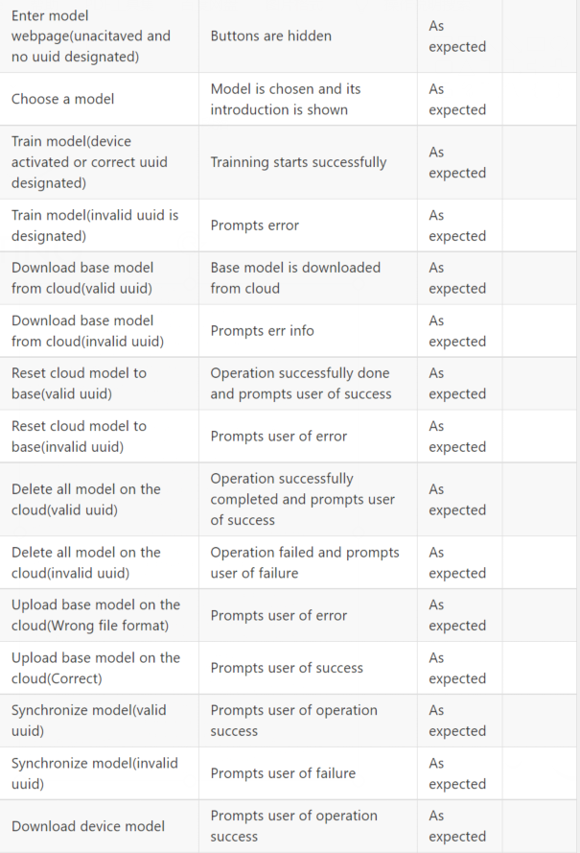
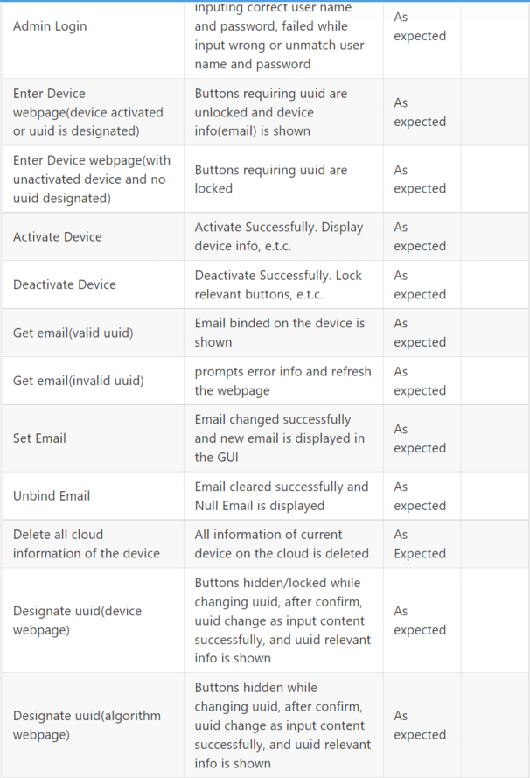
Testing case

Slide 15
Division of labor and CONTRIBUTIONS
Notes:
Next, I will introduce the division of labor in our group and talk about contributions of each member in more detail.

Slide 16
TANG HAOTIAN
Requirement Analyst
programmer
Main job
Interface code and api docking
Notes:
Tang Haotian is the programmer and requirement analyst of our group. He was mainly responsible for the interface design in the early stage and api docking with the server group. In the last few weeks, he designed the basic interface and made continuous improvement and perfection on this basis. And he completed docking with the server group, joker and associated the provided apis with interface buttons. Though he's not very good at web design, he never gives up and he's always studying related knowledge to make our interface better. As the analyst, he also finished requirement analysis and wrote some documents at the beginning. He’s also in charge of the interface deployment, as you can see in our interface website. That’s a good job.

Slide 17
CHENG WEIBIN
System architect
tester
Main job
interface style design and testing
Notes:
Cheng Weibin is the system architect and tester of our group. He was mainly responsible for the test task and system architecture. At the early stage, he drawed a data flow diagram to frame the structure of the system and did some auxiliary work for the system design. During the iteration period of our interface, he did some unit tests to find out the bugs in the code and errors in the interface button. And he would also provide some correction views for the programmer to accelerate the project progress. He also helped with the final integral test. What's more, he made contributions to our final interface, including the button layout, interface style, etc. Thanks to him, we can have such a tidy and organized interface.

Slide 18
CARLOS
tester
Main job
unit tests and testing feedback
Notes:
Carlos is from Portugal and he wrote an email to me to express his will to join us about a month ago. We were glad to have him as our teammate and since then our team has been a complete one. He is really an active guy and he's always there to do something for our team. During the past month, he always wrote email to me on his own initiative and asked what is his job as well as the progress and situation of our project. When meeting some trouble or finding something wrong, he also actively wrote me an email to reflect the problem. Despite the time difference, we can still keep in contact in time. He mainly did some unit tests and wrote some test reports to make sure our interface can operate normally. However, he met some trouble when reading our codes and it may be a little bit hard for him to study so much new things since he is also busy with his courses. So he did part of the task. But he's indeed trying his best to join us and doing something useful to make contributions to the project. He may not give an presentation tonight and that is what I said on behalf of him. But his spirits always inspire our members.

Slide 19
Pan jiazheng
Project manager
liaison
Main job
communication and document arrangement
Notes:
For me, I'm mainly responsible for the normal communication among group members, as well as document arrangement. Since this project is a group task and need all of us to finish it together, communication is significant. I make sure my Chinese teammates can communicate at any time. For our Portugal member, it may be a little troublesome to talk, but I still check my email frequently and give him timely reply to keep in contact. For the document tasks, I wrote some design documents that is required in the developing process, such as user story, use cases, guideline document and so on. Besides, I also sorted out api details from interface specification provided by Ciel to figure out the system logic, helping programmer to better design the interface. To speak the truth, I didn't participate in much code writing. But my teammates really did a good job, and I believe my document gave them some help to an extent.

Slide 20
Thank you for listening!

